Slide 1

Artificial Intelligence Course
Foundations & Fundamentals
Welcome to an exploration of Artificial Intelligence—the transformative field reshaping how machines think, learn, and interact with the world. This course introduces core concepts that form the foundation of AI research and practice.

Slide 2
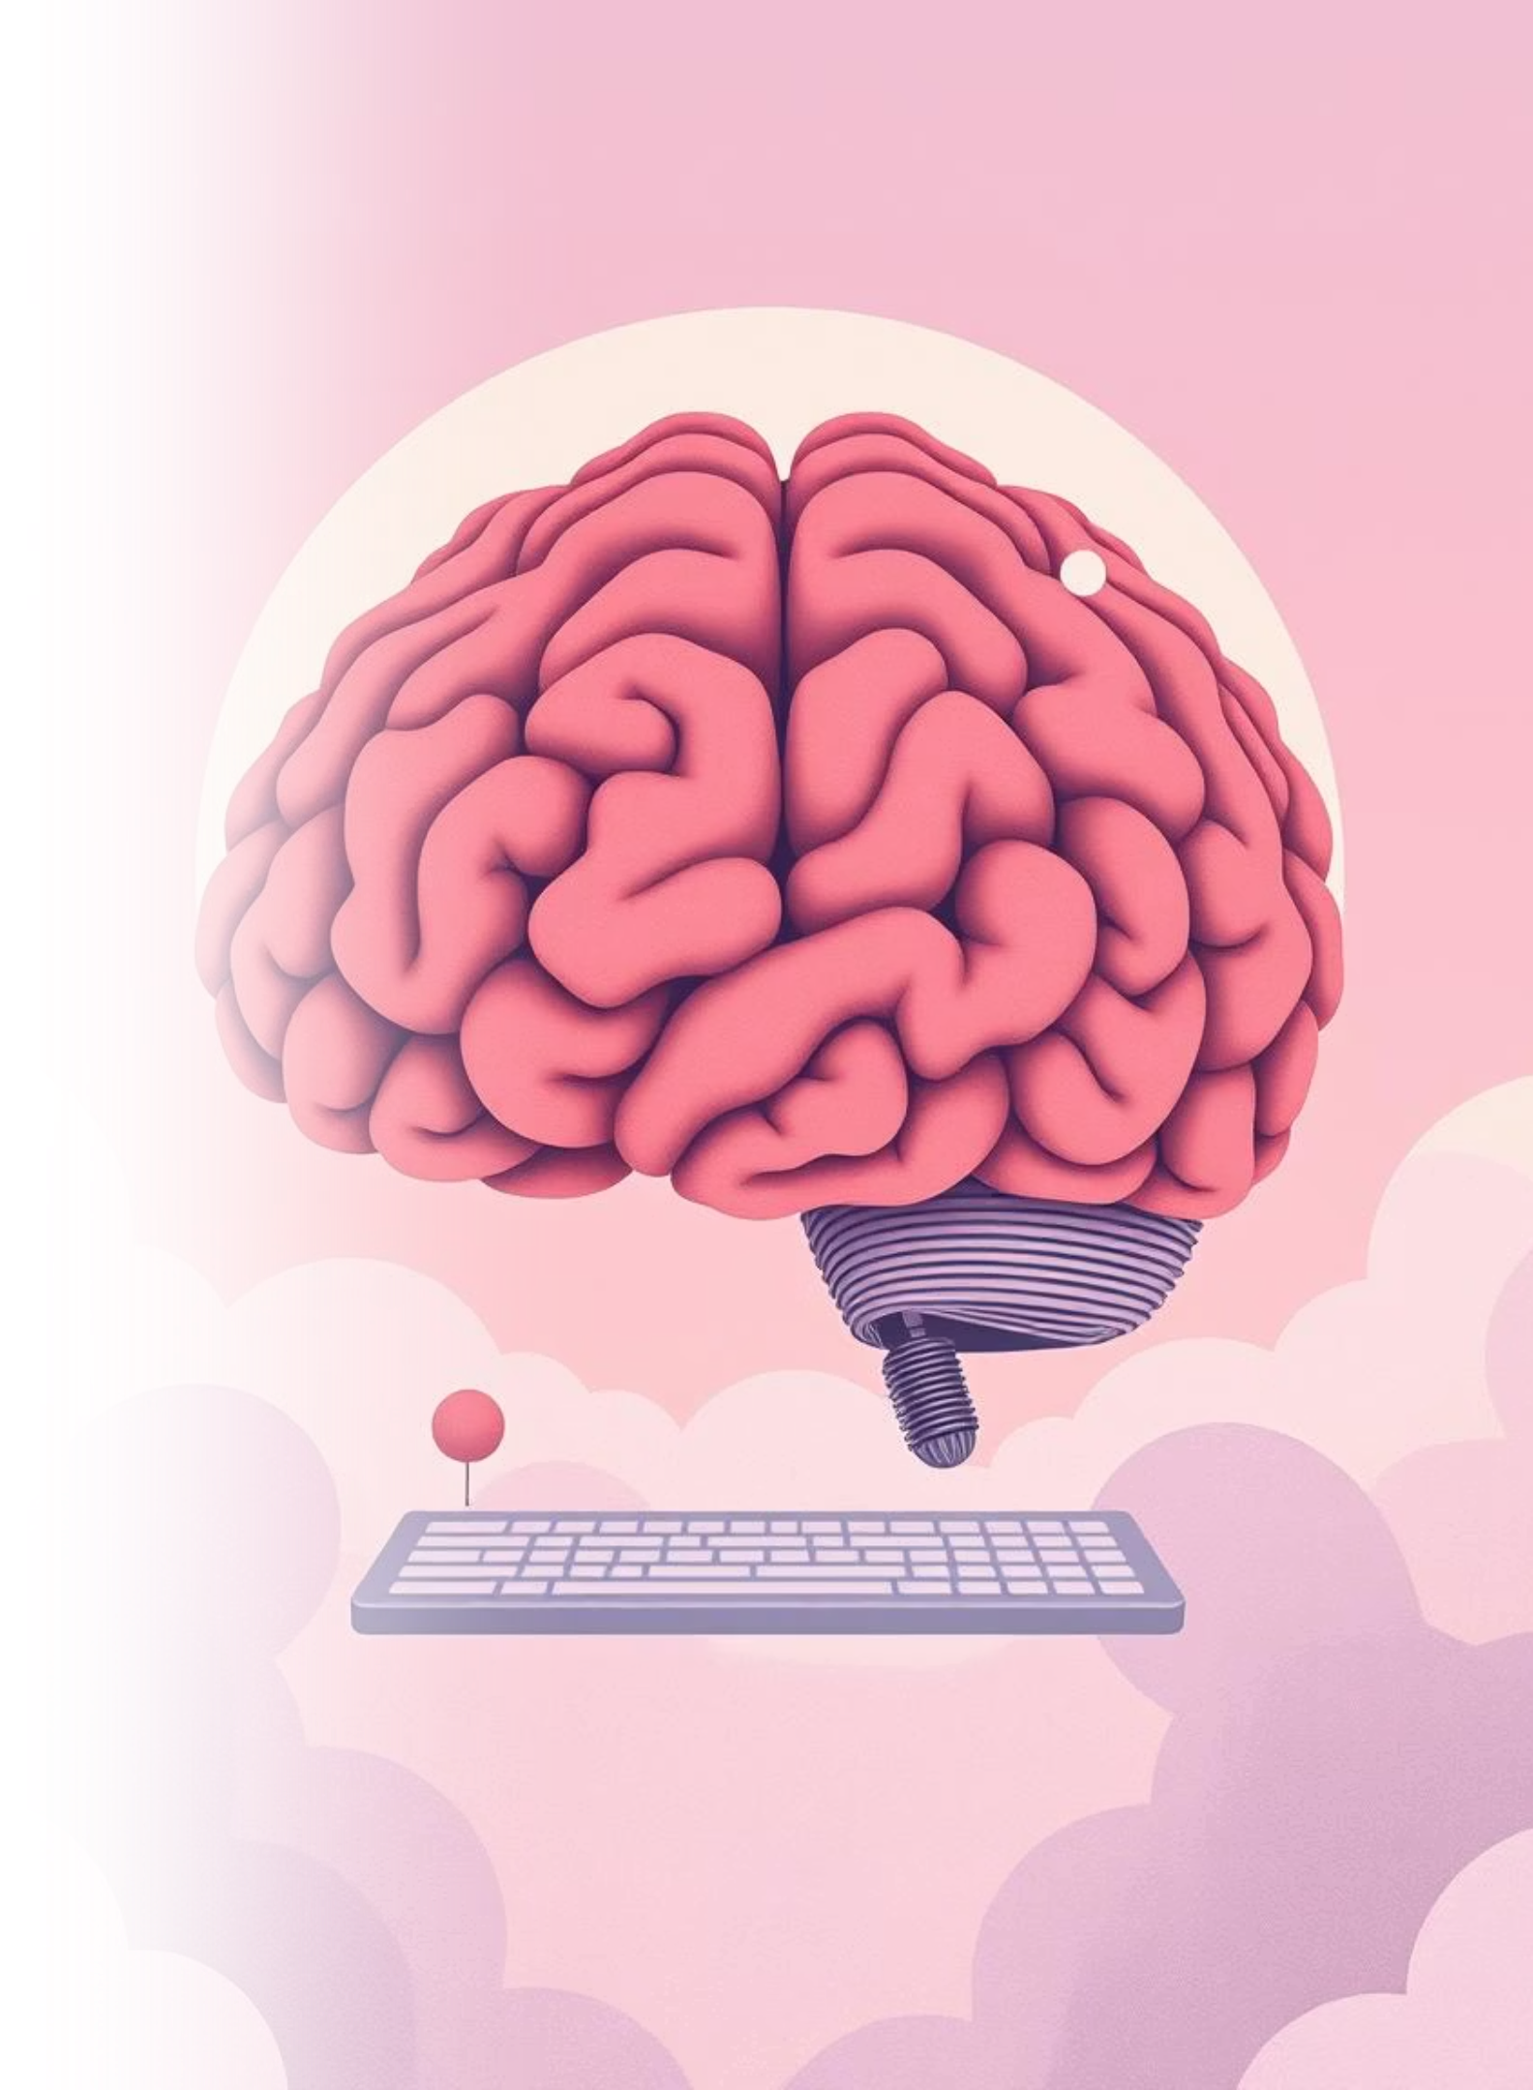
What is Artificial Intelligence?
Artificial Intelligence represents the simulation of intelligent human behavior by computational systems. AI enables machines to perceive their environment, reason about problems, learn from experience, and take actions to achieve specific goals.
Thinking
Acting
Computational reasoning and problem-solving
Taking autonomous actions in the world
Learning
Improving performance through data and experience

Slide 3





Core Goals of AI
AI research pursues ambitious objectives centered on creating intelligent systems. These foundational goals guide both theoretical inquiry and practical development across the field.
Automation
Reasoning
Learning
Automating complex, repetitive tasks
Enabling logical deduction and inference
Extracting insights from data
Perception
Natural Language
Interpreting sensory information
Understanding and generating human language

Slide 4




Real-World Applications of AI
AI technologies are actively transforming industries, enhancing human capabilities, and solving complex problems. From diagnosis to discovery, AI's impact spans nearly every sector of society.
Healthcare
Robotics
Education
Games & Strategy
Disease diagnosis, treatment planning, drug discovery
Manufacturing, autonomous vehicles, exploration
Personalized tutoring, intelligent assessment systems
Chess engines, game-playing agents, strategic reasoning

Slide 5
Foundations of Intelligence
Three perspectives frame how we understand and measure artificial intelligence, each offering unique insights into the nature of intelligent behavior.
Turing Test
Neuroscience
Rationality
Can a machine exhibit conversational behavior indistinguishable from a human? This behavioral test measures machine intelligence through imitation.
Understanding biological intelligence in brains to inspire computational systems. Cognitive science informs algorithm design and architecture.
Building systems that make optimal decisions given available information. Logic and decision theory provide rigorous foundations for rational behavior.

Slide 6

Agents in Artificial Intelligence
An agent is an autonomous computational entity that perceives its environment through sensors and acts upon it through actuators. Agents form the conceptual foundation for most AI systems, enabling sophisticated autonomous behavior through perception-action cycles.
Sensing
Acting
Perceiving the environment through various input mechanisms
Influencing the environment through strategic actions

Slide 7
Types of Intelligent Agents
AI agents vary in sophistication and capability, from reactive systems to learning entities. Each type represents different levels of complexity in decision-making and adaptation.
1
Simple Reflex Agents
Direct stimulus-response mappings without internal state or planning
2
Model-Based Agents
Maintain internal models of the world to handle partial observability
3
Goal-Based Agents
Plan actions to achieve explicit target goals
4
Utility-Based Agents
Optimize satisfaction levels, choosing actions that maximize utility and deals with happy and unhappy state
5
Learning Agents
Improve performance through experience and acquired knowledge over time

Slide 8
Types of Environments
The properties of an environment fundamentally shape which AI approaches are effective. Understanding environmental characteristics is essential for designing appropriate agent architectures and solution methods.
Dimension
Spectrum
Description
Predictability
Deterministic ↔ Stochastic
Are outcomes fixed or probabilistic?
Change
Static ↔ Dynamic
Does the environment change while the agent deliberates?
Granularity
Discrete ↔ Continuous
Are states countable or infinitely divisible?
Observability
Fully ↔ Partially Observable
Can the agent perceive the entire state?
Agents
Single ↔ Multi-Agent
Does only one agent act, or many?

Slide 9





State Space Search
Search forms the backbone of problem-solving in AI. By systematically exploring possible states and transitions, agents find solutions to complex problems. A well-defined problem specifies how we move through the space of possibilities toward goals.
State Space
The complete set of all possible configurations or situations
Initial State
The starting configuration from which search begins
Goal State(s)
Desired configuration(s) that satisfy problem objectives
Actions & Transitions
Operators that transform states, creating the search graph
Path Cost
Numerical measure evaluating solution quality and efficiency
Key Insight: Effective search strategies balance completeness, optimality, and computational efficiency to find solutions within practical constraints.

Slide 10

The N-Queen Problem
Problem Definition
Place N queens on an N×N chessboard so that no two queens threaten each other. Queens can attack horizontally, vertically, and diagonally.
Why It Matters
This classic problem demonstrates backtracking and constraint satisfaction—fundamental techniques in AI for solving complex combinatorial problems efficiently.
Solution Approach
01
02
03
Place & Check
Backtrack if Needed
Repeat & Find Solution
Position a queen on the board and verify it doesn't conflict with existing queens.
If no valid position exists, remove the previous queen and try alternative placements.
Continue until all N queens are safely placed or all possibilities are exhausted.

Slide 11

Search Algorithms in AI
1
2
Breadth First Search (BFS)
Depth First Search (DFS)
Explores all nodes at the current depth level before moving to the next, ensuring the shortest path in terms of number of edges.
Explores as far as possible along each branch before backtracking , using a stack-based or recursive approache to traverse deep paths first.
3
4
Bidirectional Search
Best First Search
Simultaneously searches forward from the start node and backward from the goal node, meeting in the middle to reduce search time exponentially.
Expands the most promising node based on a heuristic evaluation function, balancing exploration with guidance.
5
6
A* Search
Beam Search
Combines actual cost and heuristic estimate (f = g + h). Admissible heuristic guarantees optimal solutions when h never overestimates true cost.
Maintains only the top-K best nodes at each level, reducing memory while trading completeness for efficiency.

Slide 12

Hill Climbing Algorithm
Core Concept
A greedy, local search method that iteratively moves toward the steepest improving neighbor. Always selects the next state with the highest evaluation.
Key Characteristics
Simple and memory-efficient
Can get trapped in local maxima
No backtracking capability
Example: Function Maximization
Imagine a rolling landscape with hills and valleys. Hill climbing starts at a random point and always steps upward to higher ground, stopping when surrounded by lower neighbors—even if a higher peak exists elsewhere.

Slide 13




Min-Max Algorithm
A fundamental game-playing algorithm that evaluates moves by considering both the maximizing player's advantage and the minimizing opponent's counter-strategy.
Maximizing Player
Seeks the highest value outcome, selecting moves that maximize score.
Minimizing Opponent
Assumes opponent plays optimally, trying to minimize the player's gains.
Optimal Strategy
Recursively evaluates all possible game states to find the best move considering both sides.

Slide 14
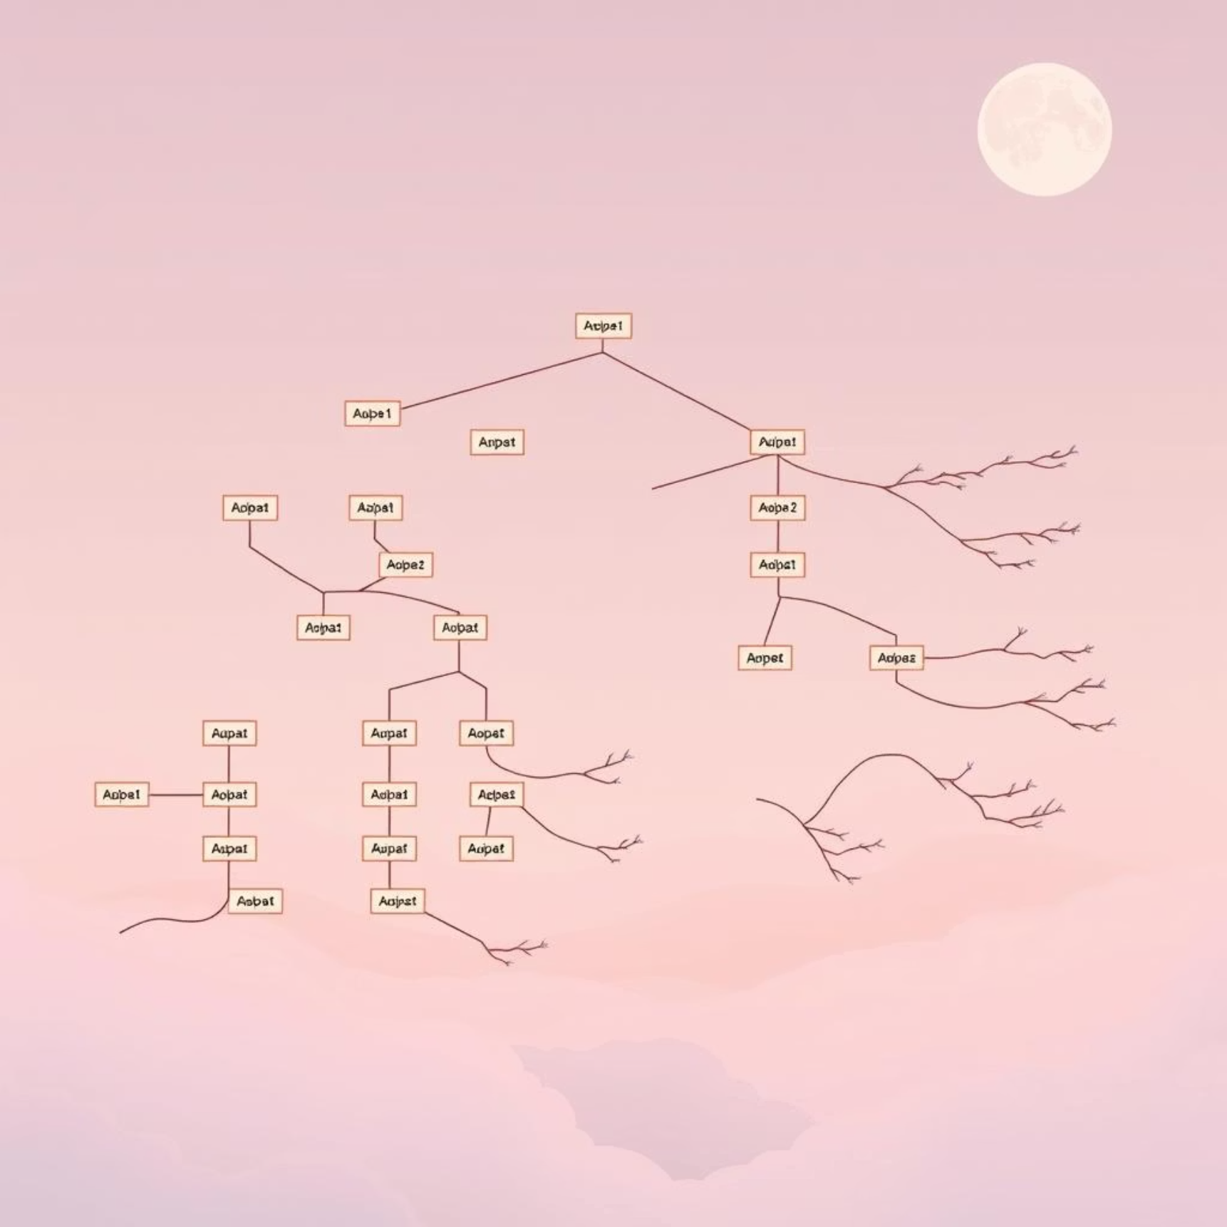
Alpha-Beta Pruning
Optimizing Min-Max Search
Alpha
Best value for maximizer found so far
Beta
Best value for minimizer found so far
Key Benefit: Eliminates entire branches that cannot affect the final decision, reducing computation by up to 50-90% without losing optimality. When alpha ≥ beta, further exploration of that branch is unnecessary.

Slide 15
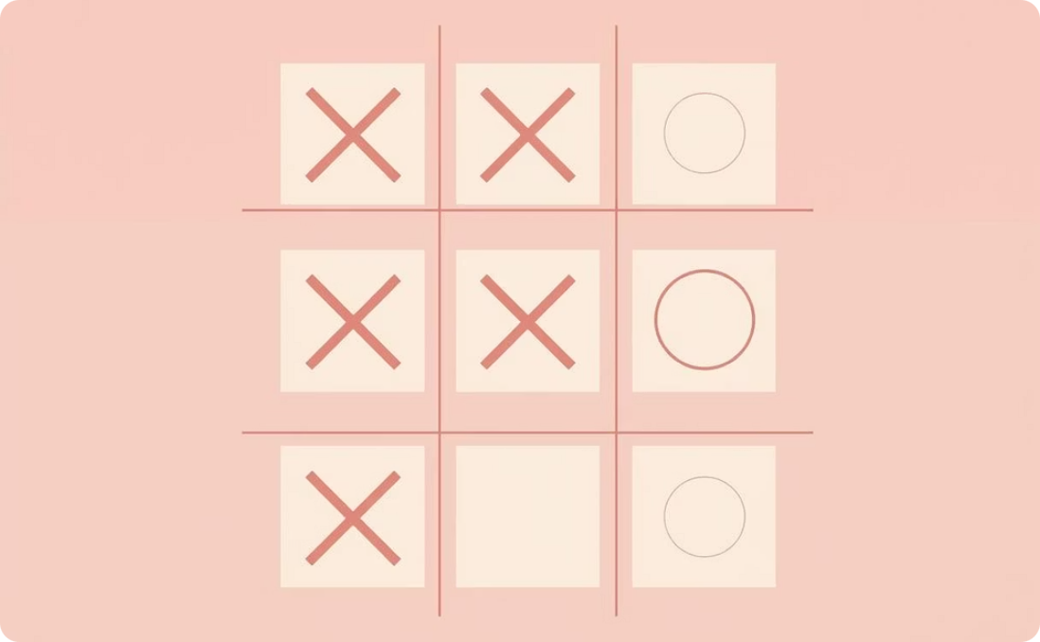


AI in Games
Games exemplify AI challenges: limited information, competitive opponents, and massive decision spaces. Different games require tailored strategies.
Tic Tac Toe
Chess
Rock Paper Scissors
Simple perfect-information game. Min-Max solves it completely, leading to draw with optimal play. Demonstrates basic game-tree evaluation.
Enormous search space (10^120 possible games). Combines Min-Max with alpha-beta pruning, heuristic evaluation, and opening/endgame databases.
Simple probabilistic game enhanced with AI using Markov-chain prediction and pattern-based counter moves.

Slide 16

Constraints in Artificial Intelligence
Constraints define restrictions or requirements that solutions must satisfy. They're essential for modeling real-world problems and guide AI systems toward valid, practical answers.
Why Constraints Matter
They reduce the search space dramatically, making problems computationally tractable and ensuring solutions meet domain requirements.
Constraint Satisfaction Problems (CSP)
Consist of variables, domains (allowed values), and constraints. Solving CSPs is fundamental to scheduling, planning, and configuration tasks.

Slide 17




Types of Constraints
Constraints are classified by scope and complexity, each serving different purposes in constraint satisfaction problems.
Unary Constraints
Binary Constraints
Restrict a single variable. Example: X ≠ 3 limits one variable's possible values.
Involve relationships between two variables. Example: X < Y ensures one variable relates correctly to another.
Global Constraints
Restrict multiple variables simultaneously. Example: All variables in a set must have different values (all-different constraint).

Slide 18

Cryptarithmetic & Bound Propagation
Cryptarithmetic Puzzle
A puzzle where letters represent digits, and mathematical operations must hold true. Each letter maps to a unique digit (0-9).
Classic Example
SEND + MORE = MONEY
Find digit assignments where this addition is arithmetically valid.
Bound Propagation
A constraint propagation technique that tightens variable domains by eliminating values inconsistent with constraints, reducing search space before exhaustive search begins.

Slide 19

Thank You
We hope this course has provided valuable insights into the exciting world of Artificial Intelligence. Continue exploring, learning, and innovating!

